Slide 1

CILogon
Middleware And Grid Interagency Coordination (MAGIC) at SC13 Jim Basney jbasney@ncsa.illinois.edu
This material is based upon work supported by the National Science Foundation under grant numbers 0943633 and 1053575 and by the Department of Energy under award number DE-SC0008597. Any opinions, findings, and conclusions or recommendations expressed in this material are those of the authors and do not necessarily reflect the views of the United States Government or any agency thereof.

Slide 2
CILogon – https://cilogon.org/
Provides personal digital certificates for access to cyberinfrastructure
Uses federated authentication for user identification

Slide 3
Federated Authentication
Log on to CILogon using your campus (InCommon) or Google (OpenID) account

Slide 4
Bridging InCommon and IGTF
Translating mechanism and policy across higher education and grid trust federations

Slide 5
refeds.org

Slide 6
edugain.org

Slide 7


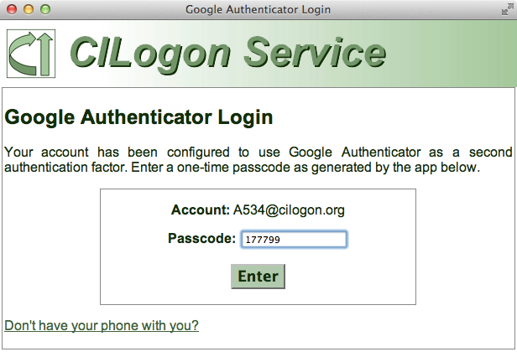
Multiple Levels of Assurance
CILogon Silver CA is accredited by IGTF
Using InCommon Silver (Level 2) identities
IGTF IOTA profile for CILogon Basic under development
Google Authenticator support for second authentication factor

Slide 8
http://wiki.eugridpma.org/Main/IOTASecuredInfraAP

Slide 9
Integrated with CyberInfrastructure

Slide 10
Integrated with Globus Online

Slide 11
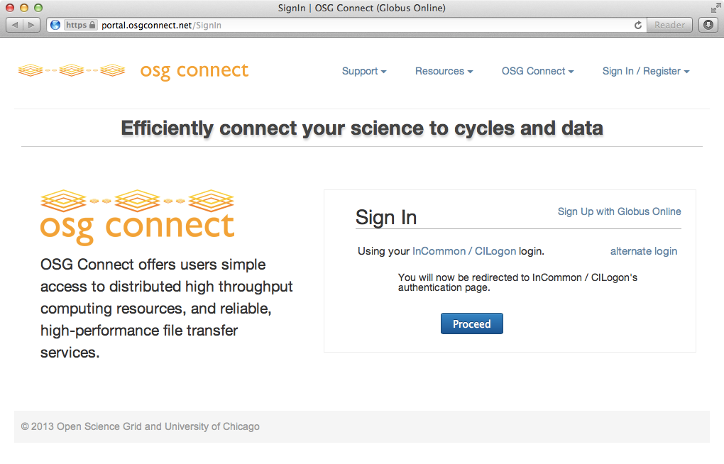
Used by OSG Connect

Slide 12
CILogon and XSEDE
CILogon
CILogon is
a component in the XSEDE architecture
entering the XSEDE engineering process: architecture, design, and security reviews and operational acceptance tests
XSEDE can provide sustained operational support to CILogon users (DataONE, OOI, OSG, LIGO, etc.)

Slide 14
Adding an IdP to CILogon
Use self-service web application or contact us for assistance
https://cilogon.org/requestidp/
https://cilogon.org/testidp/

Slide 15
InCommon Research and Scholarship program helps services connect with identity providers.

Slide 16
Registered Users Per IdP

Slide 18
% of Total Certificates Issued

Slide 20
ligo-proxy-init using CILogon ECP
$ ligo-proxy-init scott.koranda
Your identity: scott.koranda@LIGO.ORG
Enter pass phrase for this identity:
Creating proxy .................................... Done
Your proxy is valid until: Mar 5 13:45:16 2013 GMT
$ grid-proxy-info -all
subject : /DC=org/DC=cilogon/C=US/O=LIGO/CN=Scott Koranda scott.koranda@ligo.org
issuer : /DC=org/DC=cilogon/C=US/O=CILogon/CN=CILogon Basic CA 1
identity : /DC=org/DC=cilogon/C=US/O=LIGO/CN=Scott Koranda scott.koranda@ligo.org
type : end entity credential
strength : 2048 bits
path : /tmp/x509up_u1000
timeleft : 71:59:52 (3.0 days)

Slide 21
Conclusions
CILogon issues personal digital certificates using federated authentication
Bridging InCommon and IGTF
Supporting multiple levels of assurance
Integrated with cyberinfrastructure
InCommon supports cyberinfrastructure providers through the R&S program
Let’s collaborate on the use of federated identities with cyberinfrastructure!

Slide 22
Thanks!
info@cilogon.org jbasney@ncsa.illinois.edu
www.cilogon.org/faq
dx.doi.org/10.1145/2484762.2484791

